Slide 1
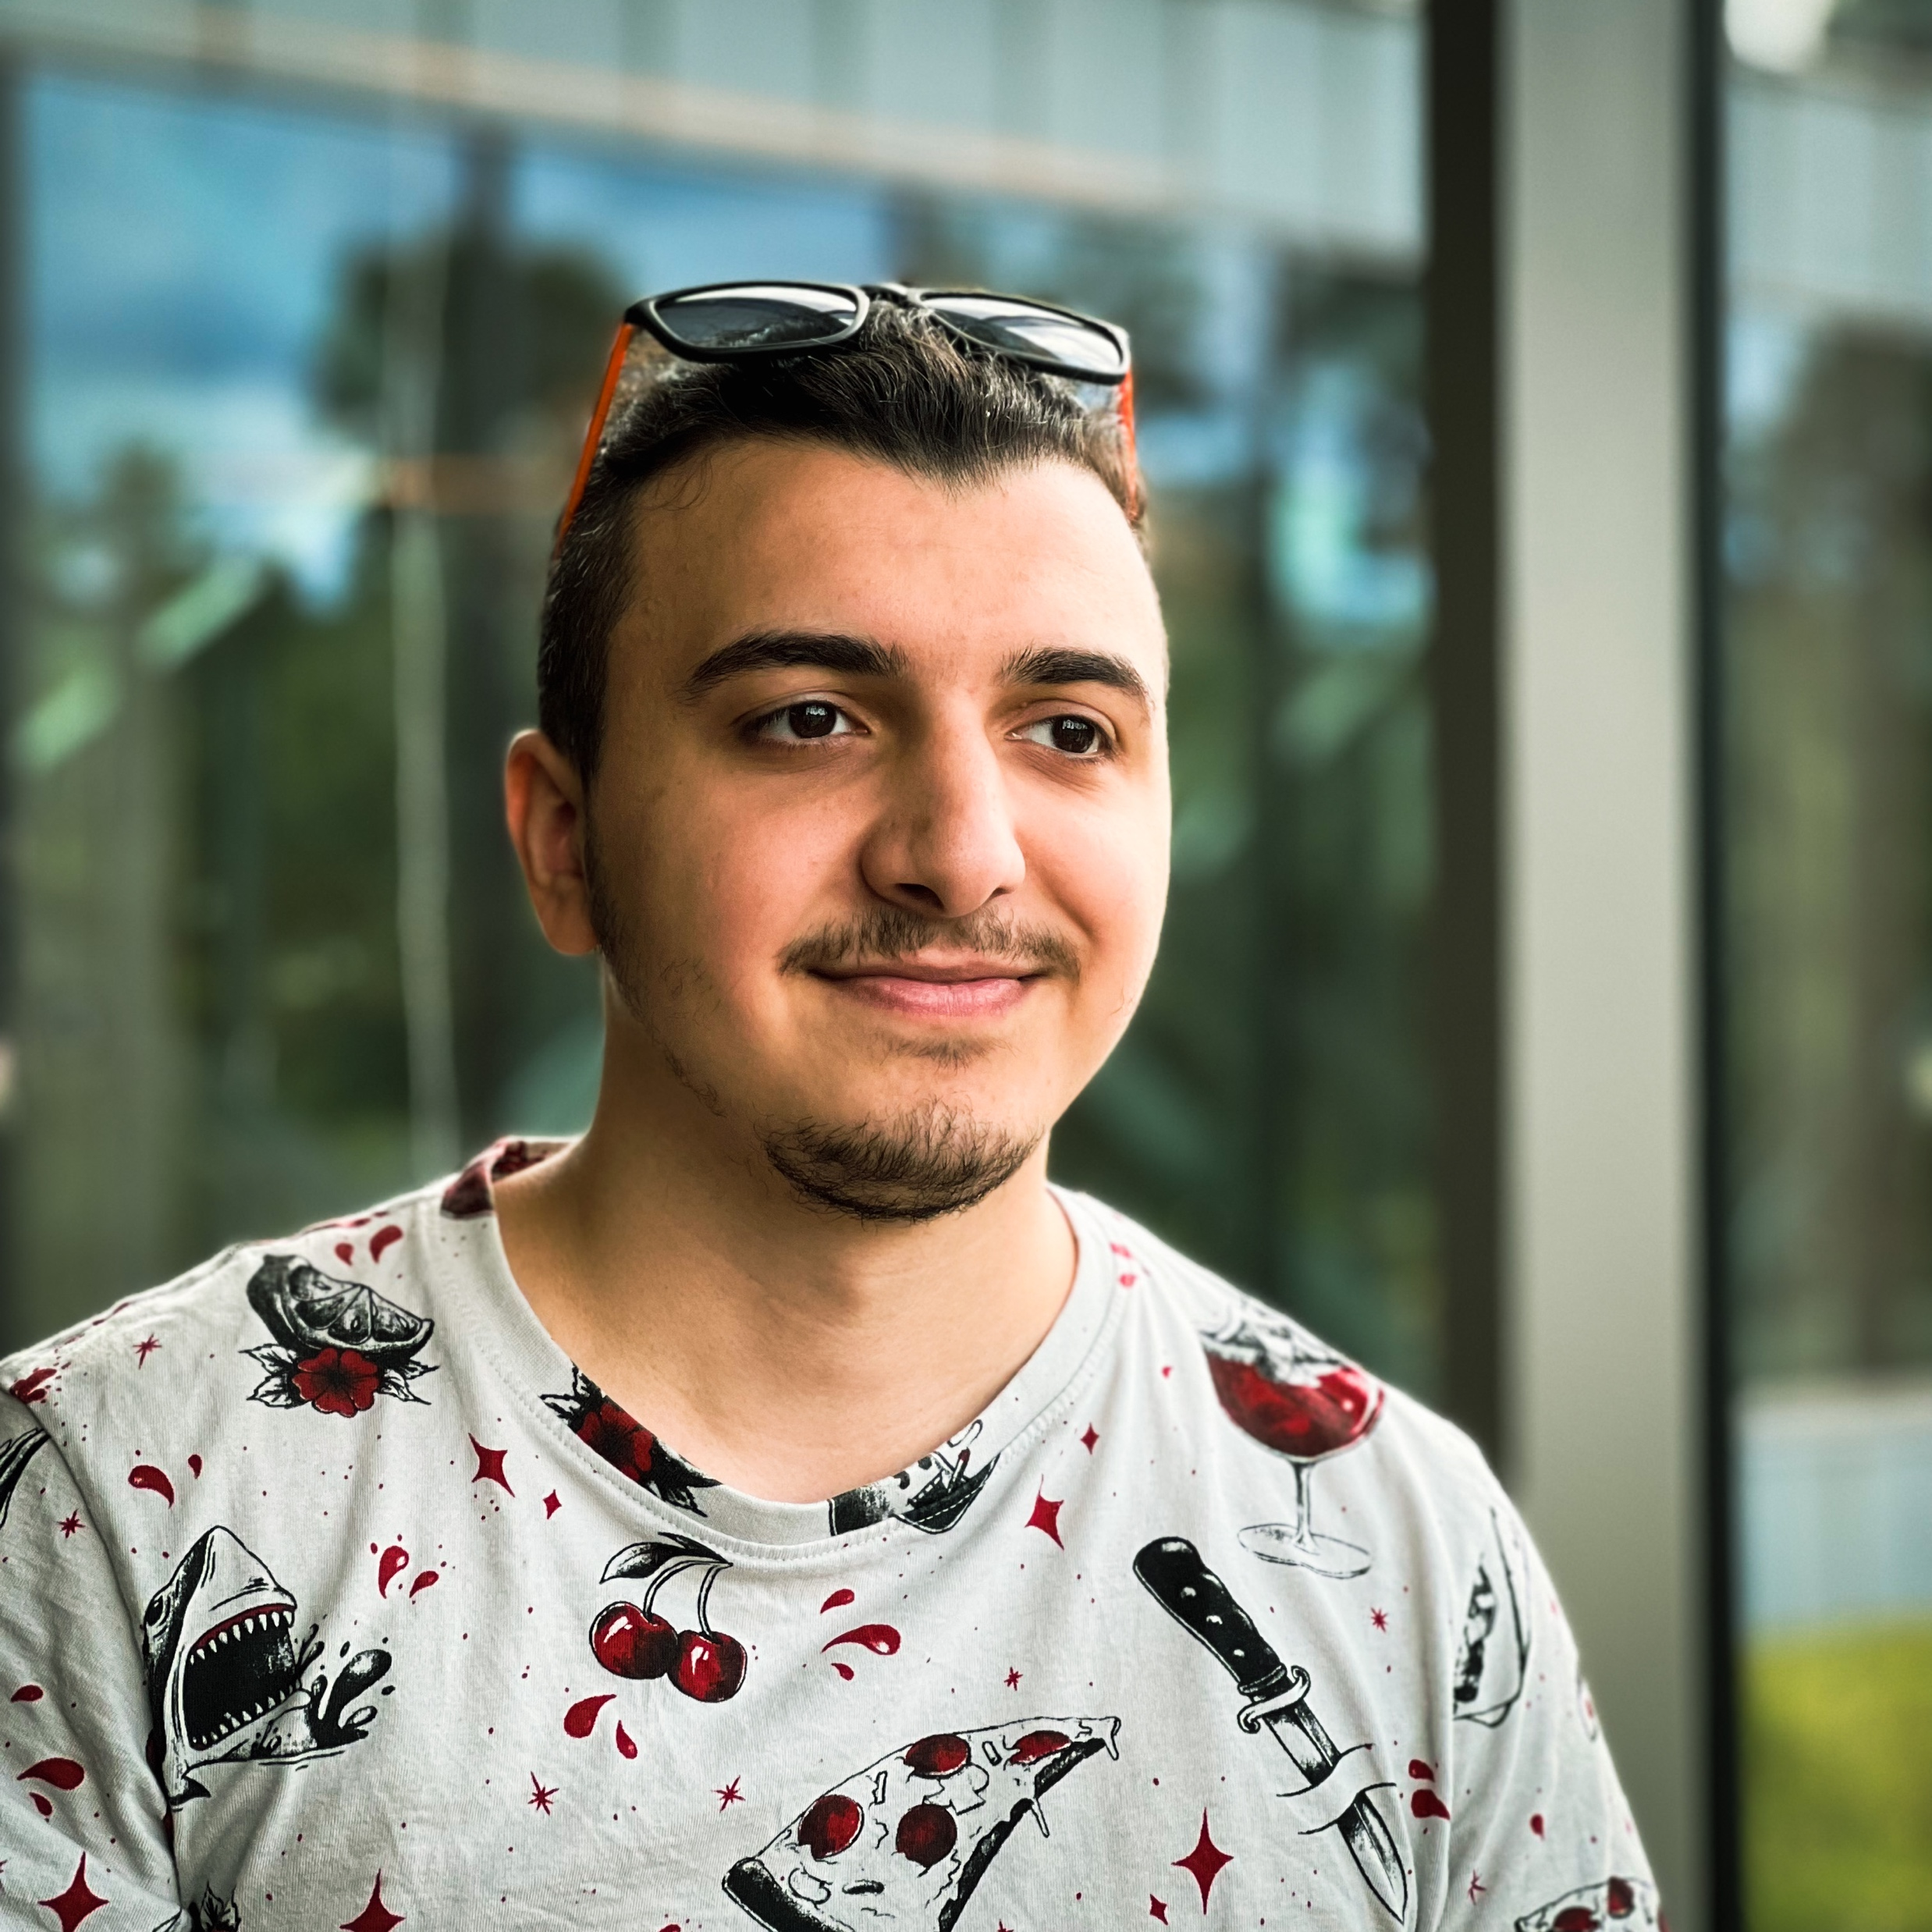
Tural Hajiyev
Software Developer

Slide 2

About
I am a qualified Software Developer who specialized in frontend technologies but also has a solid background in backend and mobile development.
~6
years of experience
I started my journey as System administrator and continuing as Software Developer
+25
companies
During my work life, I had a chance to work w/ lots of customers and see different teams and work cultures

Slide 3
Azerbaijan State Oil and Industry University
2016-2020
Information Technologies and Management
Education
Wroclaw University of Science and Technology
2022-2023
Computer Engineering | Internet Engineering

Slide 4
2016 - 2018
Total IT | Network Engineer
Plan and build network systems for different companies
Work experience
Prospect SMB | Software Developer
2020 - 2021
Design and build ERP projects
10BE5 | Software Developer
2022 - now
Work on automating the drafting of capital markets.

Slide 5
Design and implement complex systems for web and mobile applications
Technical skills
Documenting and testing exist applications, working on future features
Learn new technologies and tools from the first source

Slide 6
Communication
Good communication skills w/ every member of the team that I’m working
Soft skills
Based on my previous experiences, I can divide complex software problems and issues into small chunks and work w/ my team to fix them
Problem-solving
Time management
Proper estimations and deadlines for planned works, iterations and milestones.

Slide 7
THANKS
For more information, visit tural.dev

